Slide 1
Start
Start
Move gripper down
Home gripper height to limit switch
Turn off vacuum
Move balloon down with positive pressure onto cup
Short burst of positive pressure drops cup
Vacuum balloon to grip cup
Home gripper height to limit switch
Vacuum < 30kPa
No
Stop
Yes
Home gripper height to limit switch
Stop

Slide 2
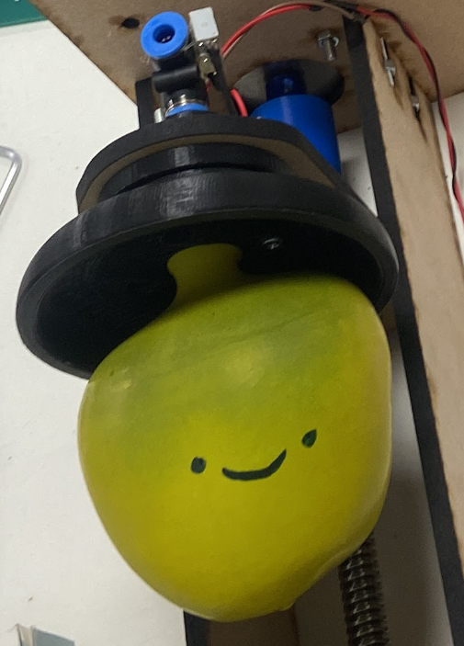
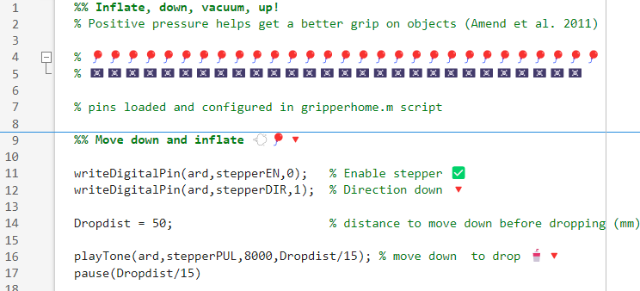
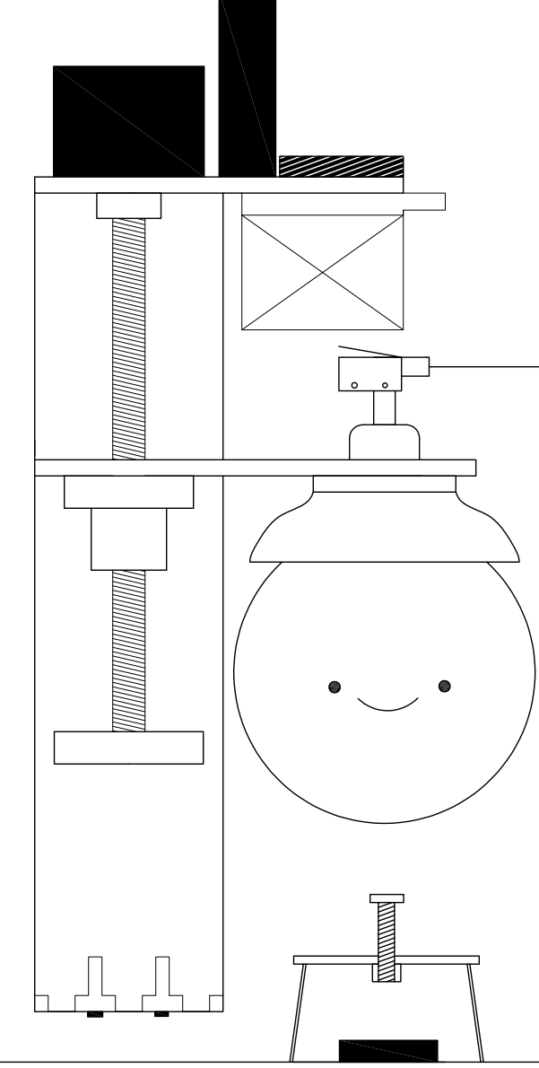
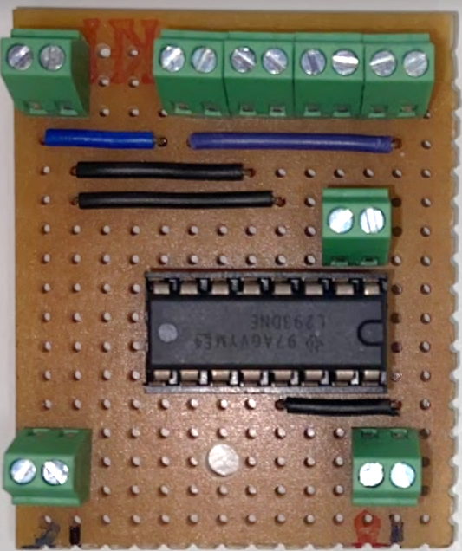
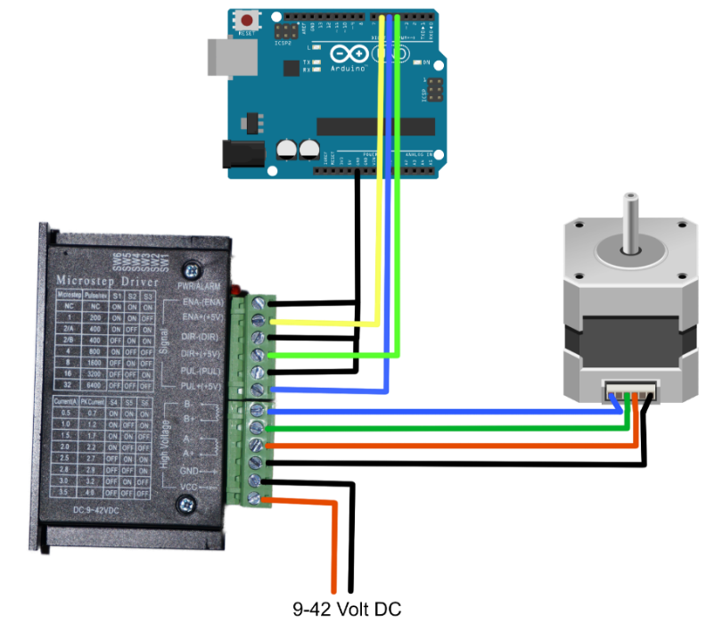
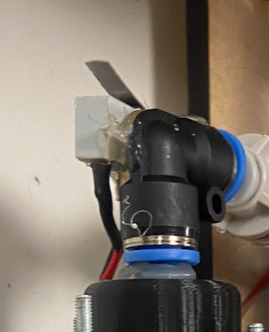
gripperpickup.m
gripperdrop.m
Software
Gripper Development
Electronics
L293D circuit
Mechanics
Balloon gripper
Stepper motor control
Gantry frame
Lead screw

